Slide 1
Candy

Slide 2

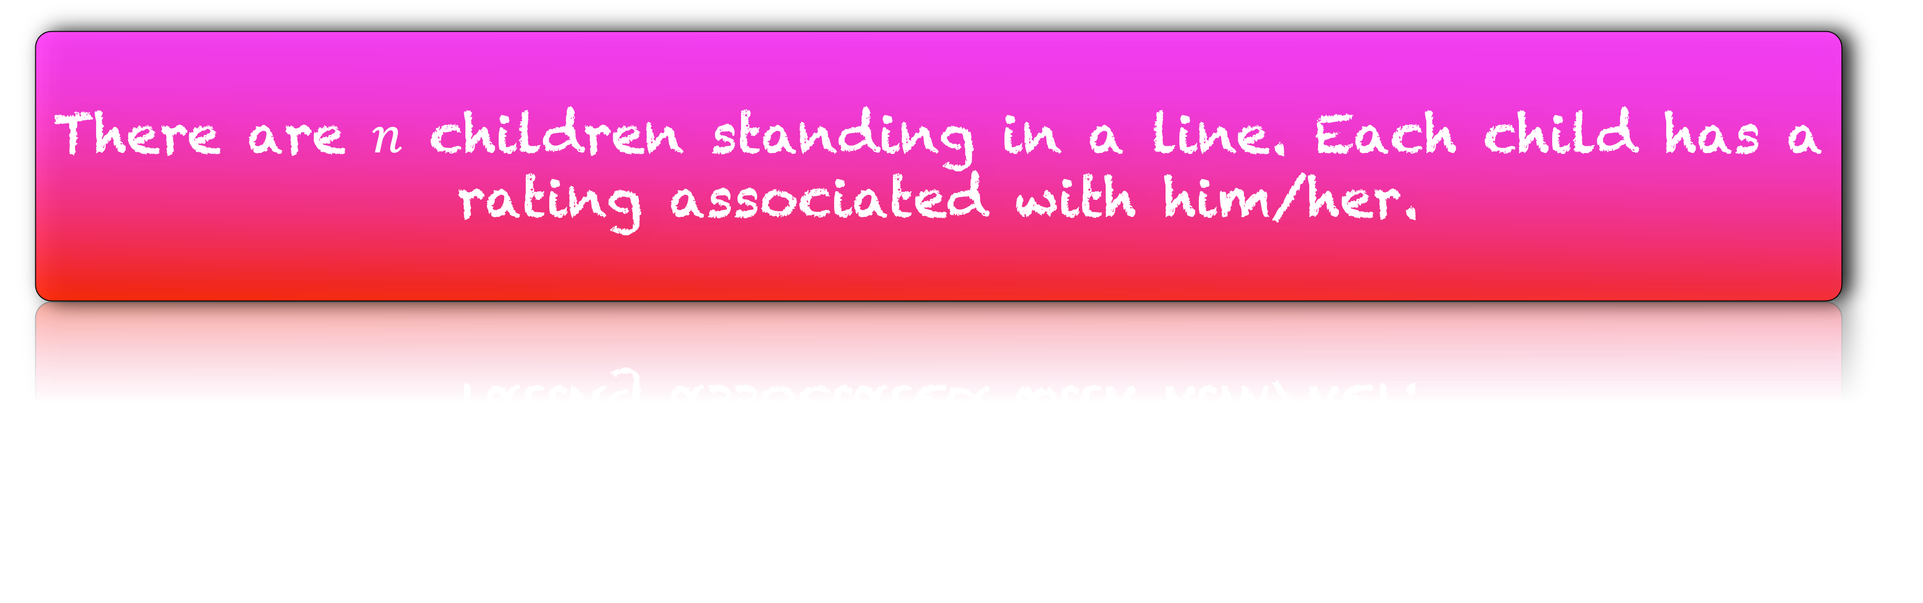
There are $n$ children standing in a line. Each child has a rating associated with him/her.
2
4
1
6
3
4
4
2
1

Slide 3

You should distribute candies to the children such that
Each child gets at least one candy.
A higher rated child get more candies than his/her lower rated neighbour
2
4
1
6
3
4
4
2
1

Slide 4
Design an algorithm that uses minimum number of candies.
2
4
1
6
3
4
4
2
1

Slide 5
6
6
5
4
4
4
4
3
3
2
2
2
1
1
1

Slide 6
6
6
5
4
4
4
4
3
3
2
2
2
1
1
1
Who should definitely get one candy?
One who is at the bottom of the valley.

Slide 7
6
6
5
4
4
4
4
3
1
2
1
2
1
1
1
Ratings
Let us assign 0 candies to others.
Assigned Candies

Slide 8
6
0
5
4
0
0
0
3
1
2
1
0
1
1
1
From each bottom point, move to the top of the mountain updating the number of candies.

Slide 9
6
0
5
4
0
0
0
3
1
2
1
0
1
1
1

Slide 10
6
0
5
4
0
0
0
3
1
2
1
0
1
1
1

Slide 11
6
2
5
4
2
2
0
3
1
2
1
2
1
1
1

Slide 12
6
2
5
4
2
2
0
3
1
2
1
2
1
1
1

Slide 13
6
2
5
4
2
2
3
3
1
2
1
2
1
1
1

Slide 14
Implementation

Slide 15
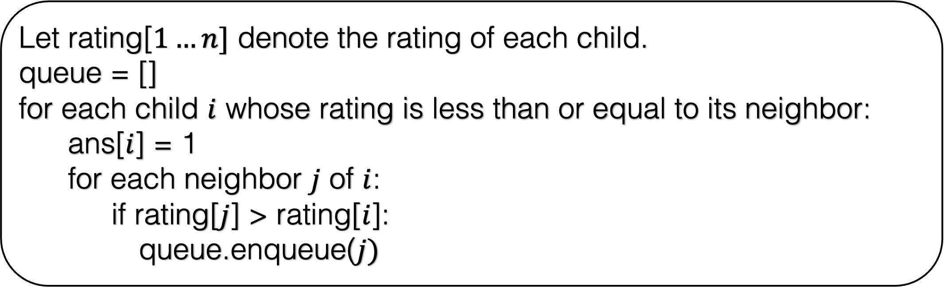
Let rating[$1…n]$ denote the rating of each child.
queue = []
for each child $i$ whose rating is less than or equal to its neighbor:
ans[$i$] = 1
for each neighbor $j$ of $i$:
if rating[$j$] > rating[$i$]:
queue.enqueue($j)$

Slide 16
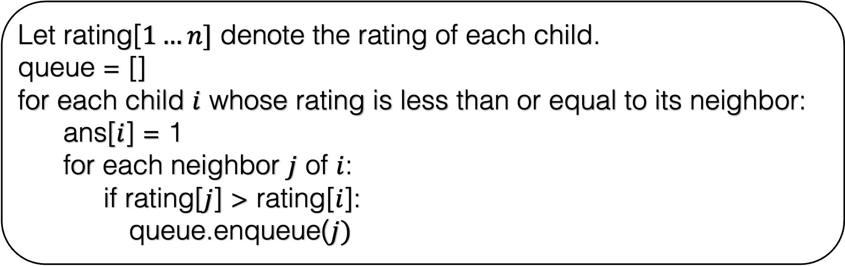
Let rating[$1…n]$ denote the rating of each child.
queue = []
for each child $i$ whose rating is less than or equal to its neighbor:
ans[$i$] = 1
for each neighbor $j$ of $i$:
if rating[$j$] > rating[$i$]:
queue.enqueue($j)$
queue
6
0
5
4
0
0
0
3
0
2
0
0
1
0
0
1
2
3
4
5
6
7
8
9

Slide 17
Let rating[$1…n]$ denote the rating of each child.
queue = []
for each child $i$ whose rating is less than or equal to its neighbor:
ans[$i$] = 1
for each neighbor $j$ of $i$:
if rating[$j$] > rating[$i$]:
queue.enqueue($j)$
queue
6
0
5
4
0
0
0
3
0
2
0
0
1
0
0
1
2
3
4
5
6
7
8
9

Slide 18
Let rating[$1…n]$ denote the rating of each child.
queue = []
for each child $i$ whose rating is less than or equal to its neighbor:
ans[$i$] = 1
for each neighbor $j$ of $i$:
if rating[$j$] > rating[$i$]:
queue.enqueue($j)$
queue
6
0
5
4
0
0
0
3
0
2
1
0
1
0
0
1
2
3
4
5
6
7
8
9

Slide 19
Let rating[$1…n]$ denote the rating of each child.
queue = []
for each child $i$ whose rating is less than or equal to its neighbor:
ans[$i$] = 1
for each neighbor $j$ of $i$:
if rating[$j$] > rating[$i$]:
queue.enqueue($j)$
queue
6
0
5
4
0
0
0
3
0
2
1
0
1
0
0
1
2
3
4
5
6
7
8
9

Slide 20
Let rating[$1…n]$ denote the rating of each child.
queue = []
for each child $i$ whose rating is less than or equal to its neighbor:
ans[$i$] = 1
for each neighbor $j$ of $i$:
if rating[$j$] > rating[$i$]:
queue.enqueue($j)$
queue
6
0
5
4
0
0
0
3
0
2
1
0
1
0
0
1
2
2
3
4
5
6
7
8
9

Slide 21
Let rating[$1…n]$ denote the rating of each child.
queue = []
for each child $i$ whose rating is less than or equal to its neighbor:
ans[$i$] = 1
for each neighbor $j$ of $i$:
if rating[$j$] > rating[$i$]:
queue.enqueue($j)$
queue
2
6
0
5
4
0
0
0
3
0
2
1
0
1
0
0
1
2
3
4
5
6
7
8
9

Slide 22
Let rating[$1…n]$ denote the rating of each child.
queue = []
for each child $i$ whose rating is less than or equal to its neighbor:
ans[$i$] = 1
for each neighbor $j$ of $i$:
if rating[$j$] > rating[$i$]:
queue.enqueue($j)$
queue
2
6
0
5
4
0
0
0
3
0
2
1
0
1
0
0
1
2
3
4
5
6
7
8
9

Slide 23
Let rating[$1…n]$ denote the rating of each child.
queue = []
for each child $i$ whose rating is less than or equal to its neighbor:
ans[$i$] = 1
for each neighbor $j$ of $i$:
if rating[$j$] > rating[$i$]:
queue.enqueue($j)$
queue
2
6
0
5
4
0
0
0
3
0
2
1
0
1
0
0
1
2
3
4
5
6
7
8
9

Slide 24
Let rating[$1…n]$ denote the rating of each child.
queue = []
for each child $i$ whose rating is less than or equal to its neighbor:
ans[$i$] = 1
for each neighbor $j$ of $i$:
if rating[$j$] > rating[$i$]:
queue.enqueue($j)$
queue
2
6
0
5
4
0
0
0
3
0
2
1
0
1
1
0
1
2
3
4
5
6
7
8
9

Slide 25
Let rating[$1…n]$ denote the rating of each child.
queue = []
for each child $i$ whose rating is less than or equal to its neighbor:
ans[$i$] = 1
for each neighbor $j$ of $i$:
if rating[$j$] > rating[$i$]:
queue.enqueue($j)$
queue
2
6
0
5
4
0
0
0
3
0
2
1
0
1
1
0
1
2
2
3
4
5
6
7
8
9

Slide 26
Let rating[$1…n]$ denote the rating of each child.
queue = []
for each child $i$ whose rating is less than or equal to its neighbor:
ans[$i$] = 1
for each neighbor $j$ of $i$:
if rating[$j$] > rating[$i$]:
queue.enqueue($j)$
queue
2
2
6
0
5
4
0
0
0
3
0
2
1
0
1
1
0
1
2
3
4
5
6
7
8
9

Slide 27
Let rating[$1…n]$ denote the rating of each child.
queue = []
for each child $i$ whose rating is less than or equal to its neighbor:
ans[$i$] = 1
for each neighbor $j$ of $i$:
if rating[$j$] > rating[$i$]:
queue.enqueue($j)$
queue
2
2
6
0
5
4
0
0
0
3
0
2
1
0
1
1
0
1
2
3
4
4
5
6
7
8
9

Slide 28
Let rating[$1…n]$ denote the rating of each child.
queue = []
for each child $i$ whose rating is less than or equal to its neighbor:
ans[$i$] = 1
for each neighbor $j$ of $i$:
if rating[$j$] > rating[$i$]:
queue.enqueue($j)$
queue
2
2
4
6
0
5
4
0
0
0
3
0
2
1
0
1
1
0
1
2
3
4
5
6
7
8
9

Slide 29
Let rating[$1…n]$ denote the rating of each child.
queue = []
for each child $i$ whose rating is less than or equal to its neighbor:
ans[$i$] = 1
for each neighbor $j$ of $i$:
if rating[$j$] > rating[$i$]:
queue.enqueue($j)$
queue
2
2
4
6
0
5
4
0
0
0
3
0
2
1
0
1
1
0
1
2
3
4
4
5
6
6
7
8
9

Slide 30
Let rating[$1…n]$ denote the rating of each child.
queue = []
for each child $i$ whose rating is less than or equal to its neighbor:
ans[$i$] = 1
for each neighbor $j$ of $i$:
if rating[$j$] > rating[$i$]:
queue.enqueue($j)$
queue
2
2
4
4
6
6
0
5
4
0
0
0
3
1
2
1
0
1
1
0
1
2
3
4
5
6
7
8
9

Slide 31
Let rating[$1…n]$ denote the rating of each child.
queue = []
for each child $i$ whose rating is less than or equal to its neighbor:
ans[$i$] = 1
for each neighbor $j$ of $i$:
if rating[$j$] > rating[$i$]:
queue.enqueue($j)$
queue
2
2
4
4
6
6
0
5
4
0
0
0
3
1
2
1
0
1
1
0
1
2
3
4
5
6
7
8
9

Slide 32
Let rating[$1…n]$ denote the rating of each child.
queue = []
for each child $i$ whose rating is less than or equal to its neighbor:
ans[$i$] = 1
for each neighbor $j$ of $i$:
if rating[$j$] > rating[$i$]:
queue.enqueue($j)$
queue
2
2
4
4
6
6
0
5
4
0
0
0
3
1
2
1
0
1
1
0
1
2
3
4
5
6
7
8
9

Slide 33
Let rating[$1…n]$ denote the rating of each child.
queue = []
for each child $i$ whose rating is less than or equal to its neighbor:
ans[$i$] = 1
for each neighbor $j$ of $i$:
if rating[$j$] > rating[$i$]:
queue.enqueue($j)$
queue
2
2
4
4
6
6
0
5
4
0
0
0
3
1
2
1
0
1
1
0
1
2
3
4
5
6
7
8
8
9

Slide 34
Let rating[$1…n]$ denote the rating of each child.
queue = []
for each child $i$ whose rating is less than or equal to its neighbor:
ans[$i$] = 1
for each neighbor $j$ of $i$:
if rating[$j$] > rating[$i$]:
queue.enqueue($j)$
queue
2
2
4
4
6
8
6
0
5
4
0
0
0
3
1
2
1
0
1
1
1
1
2
3
4
5
6
7
8
9

Slide 35
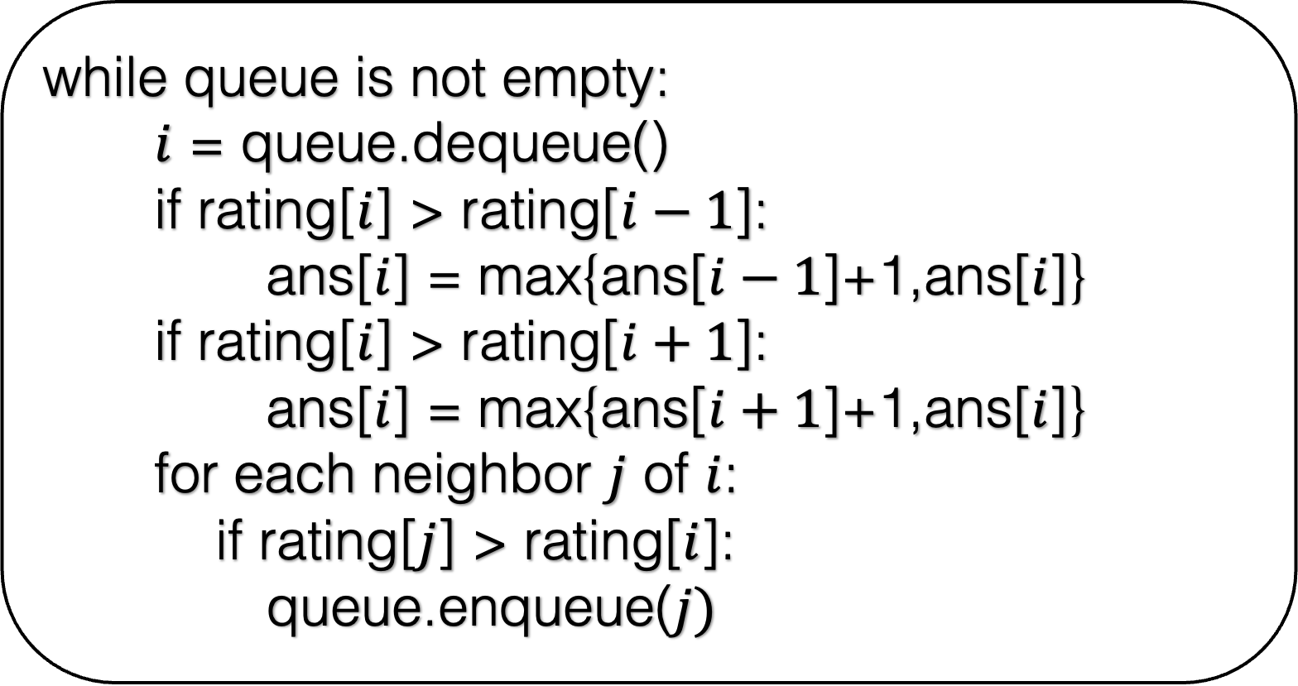
while queue is not empty:
$i$ = queue.dequeue()
if rating[$i$] > rating[$i−1$]:
ans[$i$] = max{ans[$i−1$]+1,ans[$i$]}
if rating[$i$] > rating[$i+1$]:
ans[$i$] = max{ans[$i+1$]+1,ans[$i$]}
for each neighbor $j$ of $i$:
if rating[$j$] > rating[$i$]:
queue.enqueue($j)$

Slide 36
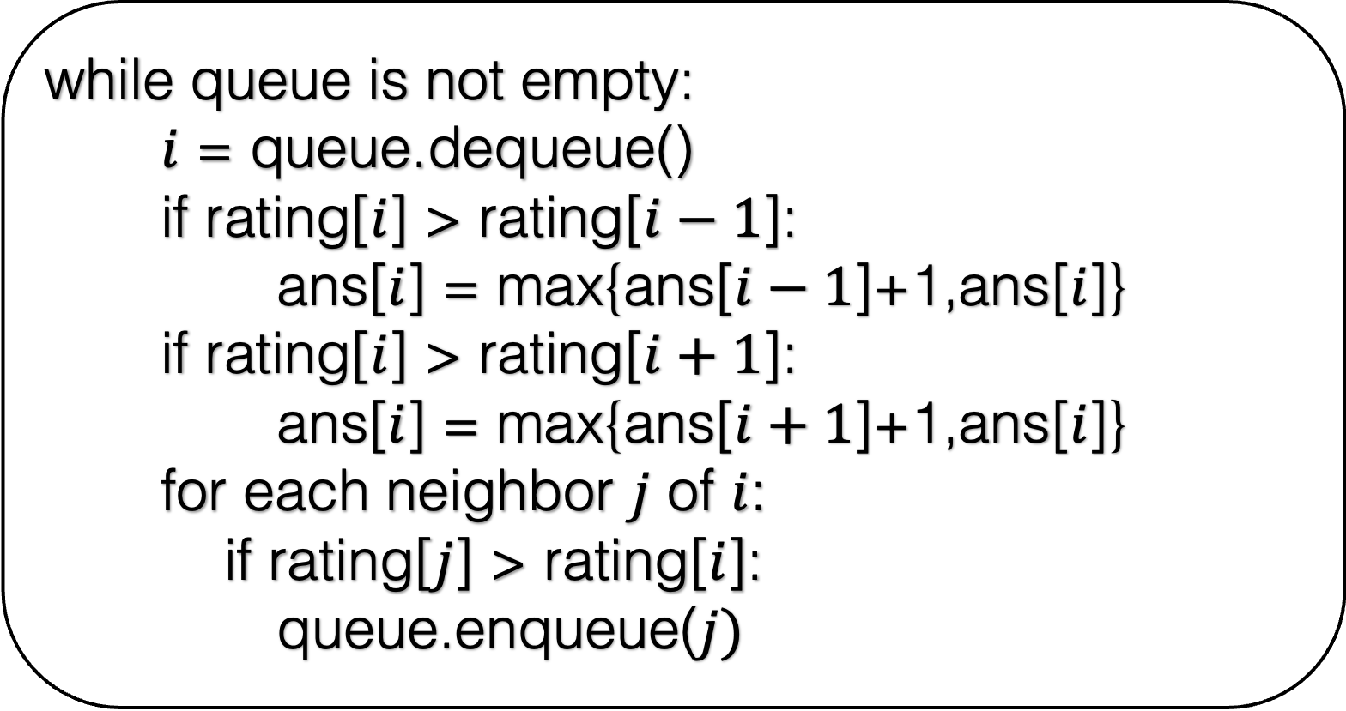
while queue is not empty:
$i$ = queue.dequeue()
if rating[$i$] > rating[$i−1$]:
ans[$i$] = max{ans[$i−1$]+1,ans[$i$]}
if rating[$i$] > rating[$i+1$]:
ans[$i$] = max{ans[$i+1$]+1,ans[$i$]}
for each neighbor $j$ of $i$:
if rating[$j$] > rating[$i$]:
queue.enqueue($j)$
queue
2
2
4
4
6
8
6
0
5
4
0
0
0
3
1
2
1
0
1
1
1
1
2
3
4
5
6
7
8
9

Slide 37
while queue is not empty:
$i$ = queue.dequeue()
if rating[$i$] > rating[$i−1$]:
ans[$i$] = max{ans[$i−1$]+1,ans[$i$]}
if rating[$i$] > rating[$i+1$]:
ans[$i$] = max{ans[$i+1$]+1,ans[$i$]}
for each neighbor $j$ of $i$:
if rating[$j$] > rating[$i$]:
queue.enqueue($j)$
queue
2
4
4
6
8
6
0
5
2
4
0
0
0
3
1
2
1
0
1
1
1
1
2
3
4
5
6
7
8
9

Slide 38
while queue is not empty:
$i$ = queue.dequeue()
if rating[$i$] > rating[$i−1$]:
ans[$i$] = max{ans[$i−1$]+1,ans[$i$]}
if rating[$i$] > rating[$i+1$]:
ans[$i$] = max{ans[$i+1$]+1,ans[$i$]}
for each neighbor $j$ of $i$:
if rating[$j$] > rating[$i$]:
queue.enqueue($j)$
queue
2
4
4
6
8
6
0
5
2
4
0
0
0
3
1
2
1
0
1
1
1
1
2
3
4
5
6
7
8
9

Slide 39
while queue is not empty:
$i$ = queue.dequeue()
if rating[$i$] > rating[$i−1$]:
ans[$i$] = max{ans[$i−1$]+1,ans[$i$]}
if rating[$i$] > rating[$i+1$]:
ans[$i$] = max{ans[$i+1$]+1,ans[$i$]}
for each neighbor $j$ of $i$:
if rating[$j$] > rating[$i$]:
queue.enqueue($j)$
queue
2
4
4
6
8
6
0
5
2
4
2
0
0
3
1
2
1
0
1
1
1
1
2
3
4
5
6
7
8
9

Slide 40
while queue is not empty:
$i$ = queue.dequeue()
if rating[$i$] > rating[$i−1$]:
ans[$i$] = max{ans[$i−1$]+1,ans[$i$]}
if rating[$i$] > rating[$i+1$]:
ans[$i$] = max{ans[$i+1$]+1,ans[$i$]}
for each neighbor $j$ of $i$:
if rating[$j$] > rating[$i$]:
queue.enqueue($j)$
queue
2
4
4
6
8
6
0
5
2
4
2
0
0
3
1
2
1
0
1
1
1
1
2
3
4
5
6
7
8
9

Slide 41
while queue is not empty:
$i$ = queue.dequeue()
if rating[$i$] > rating[$i−1$]:
ans[$i$] = max{ans[$i−1$]+1,ans[$i$]}
if rating[$i$] > rating[$i+1$]:
ans[$i$] = max{ans[$i+1$]+1,ans[$i$]}
for each neighbor $j$ of $i$:
if rating[$j$] > rating[$i$]:
queue.enqueue($j)$
queue
2
4
4
6
8
6
0
5
2
4
2
0
0
3
1
2
1
0
1
1
1
1
2
3
4
5
6
7
8
9

Slide 42
while queue is not empty:
$i$ = queue.dequeue()
if rating[$i$] > rating[$i−1$]:
ans[$i$] = max{ans[$i−1$]+1,ans[$i$]}
if rating[$i$] > rating[$i+1$]:
ans[$i$] = max{ans[$i+1$]+1,ans[$i$]}
for each neighbor $j$ of $i$:
if rating[$j$] > rating[$i$]:
queue.enqueue($j)$
queue
2
4
4
6
8
6
0
5
2
4
2
0
0
3
1
2
1
0
1
1
1
1
2
3
4
5
6
7
8
9

Slide 43
while queue is not empty:
$i$ = queue.dequeue()
if rating[$i$] > rating[$i−1$]:
ans[$i$] = max{ans[$i−1$]+1,ans[$i$]}
if rating[$i$] > rating[$i+1$]:
ans[$i$] = max{ans[$i+1$]+1,ans[$i$]}
for each neighbor $j$ of $i$:
if rating[$j$] > rating[$i$]:
queue.enqueue($j)$
queue
2
4
4
6
8
6
0
5
4
2
0
0
3
1
2
1
0
1
1
1
1
2
3
4
5
6
7
8
9

Slide 44
while queue is not empty:
$i$ = queue.dequeue()
if rating[$i$] > rating[$i−1$]:
ans[$i$] = max{ans[$i−1$]+1,ans[$i$]}
if rating[$i$] > rating[$i+1$]:
ans[$i$] = max{ans[$i+1$]+1,ans[$i$]}
for each neighbor $j$ of $i$:
if rating[$j$] > rating[$i$]:
queue.enqueue($j)$
queue
4
4
6
8
6
0
5
2
4
2
0
0
3
1
2
1
0
1
1
1
1
2
3
4
5
6
7
8
9

Slide 45
while queue is not empty:
$i$ = queue.dequeue()
if rating[$i$] > rating[$i−1$]:
ans[$i$] = max{ans[$i−1$]+1,ans[$i$]}
if rating[$i$] > rating[$i+1$]:
ans[$i$] = max{ans[$i+1$]+1,ans[$i$]}
for each neighbor $j$ of $i$:
if rating[$j$] > rating[$i$]:
queue.enqueue($j)$
queue
4
6
8
4
6
0
5
4
2
0
0
3
1
2
1
0
1
1
1
1
2
3
4
5
6
7
8
9

Slide 46
while queue is not empty:
$i$ = queue.dequeue()
if rating[$i$] > rating[$i−1$]:
ans[$i$] = max{ans[$i−1$]+1,ans[$i$]}
if rating[$i$] > rating[$i+1$]:
ans[$i$] = max{ans[$i+1$]+1,ans[$i$]}
for each neighbor $j$ of $i$:
if rating[$j$] > rating[$i$]:
queue.enqueue($j)$
queue
4
6
8
4
6
2
5
4
2
0
0
3
1
2
1
0
1
1
1
1
2
3
4
5
6
7
8
9

Slide 47
while queue is not empty:
$i$ = queue.dequeue()
if rating[$i$] > rating[$i−1$]:
ans[$i$] = max{ans[$i−1$]+1,ans[$i$]}
if rating[$i$] > rating[$i+1$]:
ans[$i$] = max{ans[$i+1$]+1,ans[$i$]}
for each neighbor $j$ of $i$:
if rating[$j$] > rating[$i$]:
queue.enqueue($j)$
queue
6
8
4
6
2
5
4
2
0
0
3
1
2
1
0
1
1
1
1
2
3
4
5
6
7
8
9

Slide 48
while queue is not empty:
$i$ = queue.dequeue()
if rating[$i$] > rating[$i−1$]:
ans[$i$] = max{ans[$i−1$]+1,ans[$i$]}
if rating[$i$] > rating[$i+1$]:
ans[$i$] = max{ans[$i+1$]+1,ans[$i$]}
for each neighbor $j$ of $i$:
if rating[$j$] > rating[$i$]:
queue.enqueue($j)$
queue
8
6
2
5
6
4
2
0
0
3
1
2
1
0
1
1
1
1
2
3
4
5
6
7
8
9

Slide 49
while queue is not empty:
$i$ = queue.dequeue()
if rating[$i$] > rating[$i−1$]:
ans[$i$] = max{ans[$i−1$]+1,ans[$i$]}
if rating[$i$] > rating[$i+1$]:
ans[$i$] = max{ans[$i+1$]+1,ans[$i$]}
for each neighbor $j$ of $i$:
if rating[$j$] > rating[$i$]:
queue.enqueue($j)$
queue
8
6
2
5
6
4
2
2
0
3
1
2
1
0
1
1
1
1
2
3
4
5
6
7
8
9

Slide 50
while queue is not empty:
$i$ = queue.dequeue()
if rating[$i$] > rating[$i−1$]:
ans[$i$] = max{ans[$i−1$]+1,ans[$i$]}
if rating[$i$] > rating[$i+1$]:
ans[$i$] = max{ans[$i+1$]+1,ans[$i$]}
for each neighbor $j$ of $i$:
if rating[$j$] > rating[$i$]:
queue.enqueue($j)$
queue
6
2
5
4
2
2
0
3
1
8
2
1
0
1
1
1
1
2
3
4
5
6
7
8
9

Slide 51
while queue is not empty:
$i$ = queue.dequeue()
if rating[$i$] > rating[$i−1$]:
ans[$i$] = max{ans[$i−1$]+1,ans[$i$]}
if rating[$i$] > rating[$i+1$]:
ans[$i$] = max{ans[$i+1$]+1,ans[$i$]}
for each neighbor $j$ of $i$:
if rating[$j$] > rating[$i$]:
queue.enqueue($j)$
queue
6
2
5
4
2
2
0
3
1
8
2
1
0
1
1
1
1
2
3
4
5
6
7
8
9

Slide 52
while queue is not empty:
$i$ = queue.dequeue()
if rating[$i$] > rating[$i−1$]:
ans[$i$] = max{ans[$i−1$]+1,ans[$i$]}
if rating[$i$] > rating[$i+1$]:
ans[$i$] = max{ans[$i+1$]+1,ans[$i$]}
for each neighbor $j$ of $i$:
if rating[$j$] > rating[$i$]:
queue.enqueue($j)$
queue
6
2
5
4
2
2
0
3
1
8
2
1
0
1
1
1
1
2
3
4
5
6
7
8
9

Slide 53
while queue is not empty:
$i$ = queue.dequeue()
if rating[$i$] > rating[$i−1$]:
ans[$i$] = max{ans[$i−1$]+1,ans[$i$]}
if rating[$i$] > rating[$i+1$]:
ans[$i$] = max{ans[$i+1$]+1,ans[$i$]}
for each neighbor $j$ of $i$:
if rating[$j$] > rating[$i$]:
queue.enqueue($j)$
queue
6
2
5
4
2
2
0
3
1
8
2
1
2
1
1
1
1
2
3
4
5
6
7
8
9

Slide 54
while queue is not empty:
$i$ = queue.dequeue()
if rating[$i$] > rating[$i−1$]:
ans[$i$] = max{ans[$i−1$]+1,ans[$i$]}
if rating[$i$] > rating[$i+1$]:
ans[$i$] = max{ans[$i+1$]+1,ans[$i$]}
for each neighbor $j$ of $i$:
if rating[$j$] > rating[$i$]:
queue.enqueue($j)$
queue
6
2
5
4
2
2
0
3
1
8
2
1
2
1
1
1
1
2
3
4
5
6
7
8
9

Slide 55
while queue is not empty:
$i$ = queue.dequeue()
if rating[$i$] > rating[$i−1$]:
ans[$i$] = max{ans[$i−1$]+1,ans[$i$]}
if rating[$i$] > rating[$i+1$]:
ans[$i$] = max{ans[$i+1$]+1,ans[$i$]}
for each neighbor $j$ of $i$:
if rating[$j$] > rating[$i$]:
queue.enqueue($j)$
queue
6
2
5
4
2
2
0
3
1
8
2
1
2
1
1
1
1
2
3
4
5
6
7
7
8
9

Slide 56
while queue is not empty:
$i$ = queue.dequeue()
if rating[$i$] > rating[$i−1$]:
ans[$i$] = max{ans[$i−1$]+1,ans[$i$]}
if rating[$i$] > rating[$i+1$]:
ans[$i$] = max{ans[$i+1$]+1,ans[$i$]}
for each neighbor $j$ of $i$:
if rating[$j$] > rating[$i$]:
queue.enqueue($j)$
queue
7
6
2
5
4
2
2
0
3
1
8
2
1
2
1
1
1
1
2
3
4
5
6
7
8
9

Slide 57
while queue is not empty:
$i$ = queue.dequeue()
if rating[$i$] > rating[$i−1$]:
ans[$i$] = max{ans[$i−1$]+1,ans[$i$]}
if rating[$i$] > rating[$i+1$]:
ans[$i$] = max{ans[$i+1$]+1,ans[$i$]}
for each neighbor $j$ of $i$:
if rating[$j$] > rating[$i$]:
queue.enqueue($j)$
queue
7
6
2
5
4
2
2
0
3
1
2
1
2
1
1
1
1
2
3
4
5
6
7
8
9

Slide 58
while queue is not empty:
$i$ = queue.dequeue()
if rating[$i$] > rating[$i−1$]:
ans[$i$] = max{ans[$i−1$]+1,ans[$i$]}
if rating[$i$] > rating[$i+1$]:
ans[$i$] = max{ans[$i+1$]+1,ans[$i$]}
for each neighbor $j$ of $i$:
if rating[$j$] > rating[$i$]:
queue.enqueue($j)$
queue
6
2
5
7
4
2
2
0
3
1
2
1
2
1
1
1
1
2
3
4
5
6
7
8
9

Slide 59
while queue is not empty:
$i$ = queue.dequeue()
if rating[$i$] > rating[$i−1$]:
ans[$i$] = max{ans[$i−1$]+1,ans[$i$]}
if rating[$i$] > rating[$i+1$]:
ans[$i$] = max{ans[$i+1$]+1,ans[$i$]}
for each neighbor $j$ of $i$:
if rating[$j$] > rating[$i$]:
queue.enqueue($j)$
queue
6
2
5
7
4
2
2
3
3
1
2
1
2
1
1
1
1
2
3
4
5
6
7
8
9

Slide 60
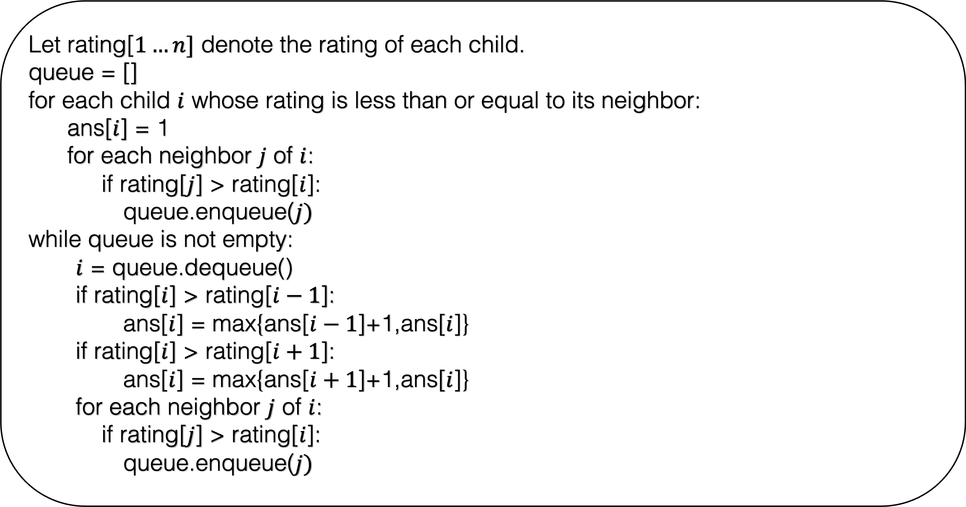
Let rating[$1…n]$ denote the rating of each child.
queue = []
for each child $i$ whose rating is less than or equal to its neighbor:
ans[$i$] = 1
for each neighbor $j$ of $i$:
if rating[$j$] > rating[$i$]:
queue.enqueue($j)$
while queue is not empty:
$i$ = queue.dequeue()
if rating[$i$] > rating[$i−1$]:
ans[$i$] = max{ans[$i−1$]+1,ans[$i$]}
if rating[$i$] > rating[$i+1$]:
ans[$i$] = max{ans[$i+1$]+1,ans[$i$]}
for each neighbor $j$ of $i$:
if rating[$j$] > rating[$i$]:
queue.enqueue($j)$
Write a proper code for this problem that handles all the corner cases.

Slide 61
Let rating[$1…n]$ denote the rating of each child.
queue = []
for each child $i$ whose rating is less than or equal to its neighbor:
ans[$i$] = 1
for each neighbor $j$ of $i$:
if rating[$j$] > rating[$i$]:
queue.enqueue($j)$
while queue is not empty:
$i$ = queue.dequeue()
if rating[$i$] > rating[$i−1$]:
ans[$i$] = max{ans[$i−1$]+1,ans[$i$]}
if rating[$i$] > rating[$i+1$]:
ans[$i$] = max{ans[$i+1$]+1,ans[$i$]}
for each neighbor $j$ of $i$:
if rating[$j$] > rating[$i$]:
queue.enqueue($j)$
What is the running time of the algorithm?

Slide 62

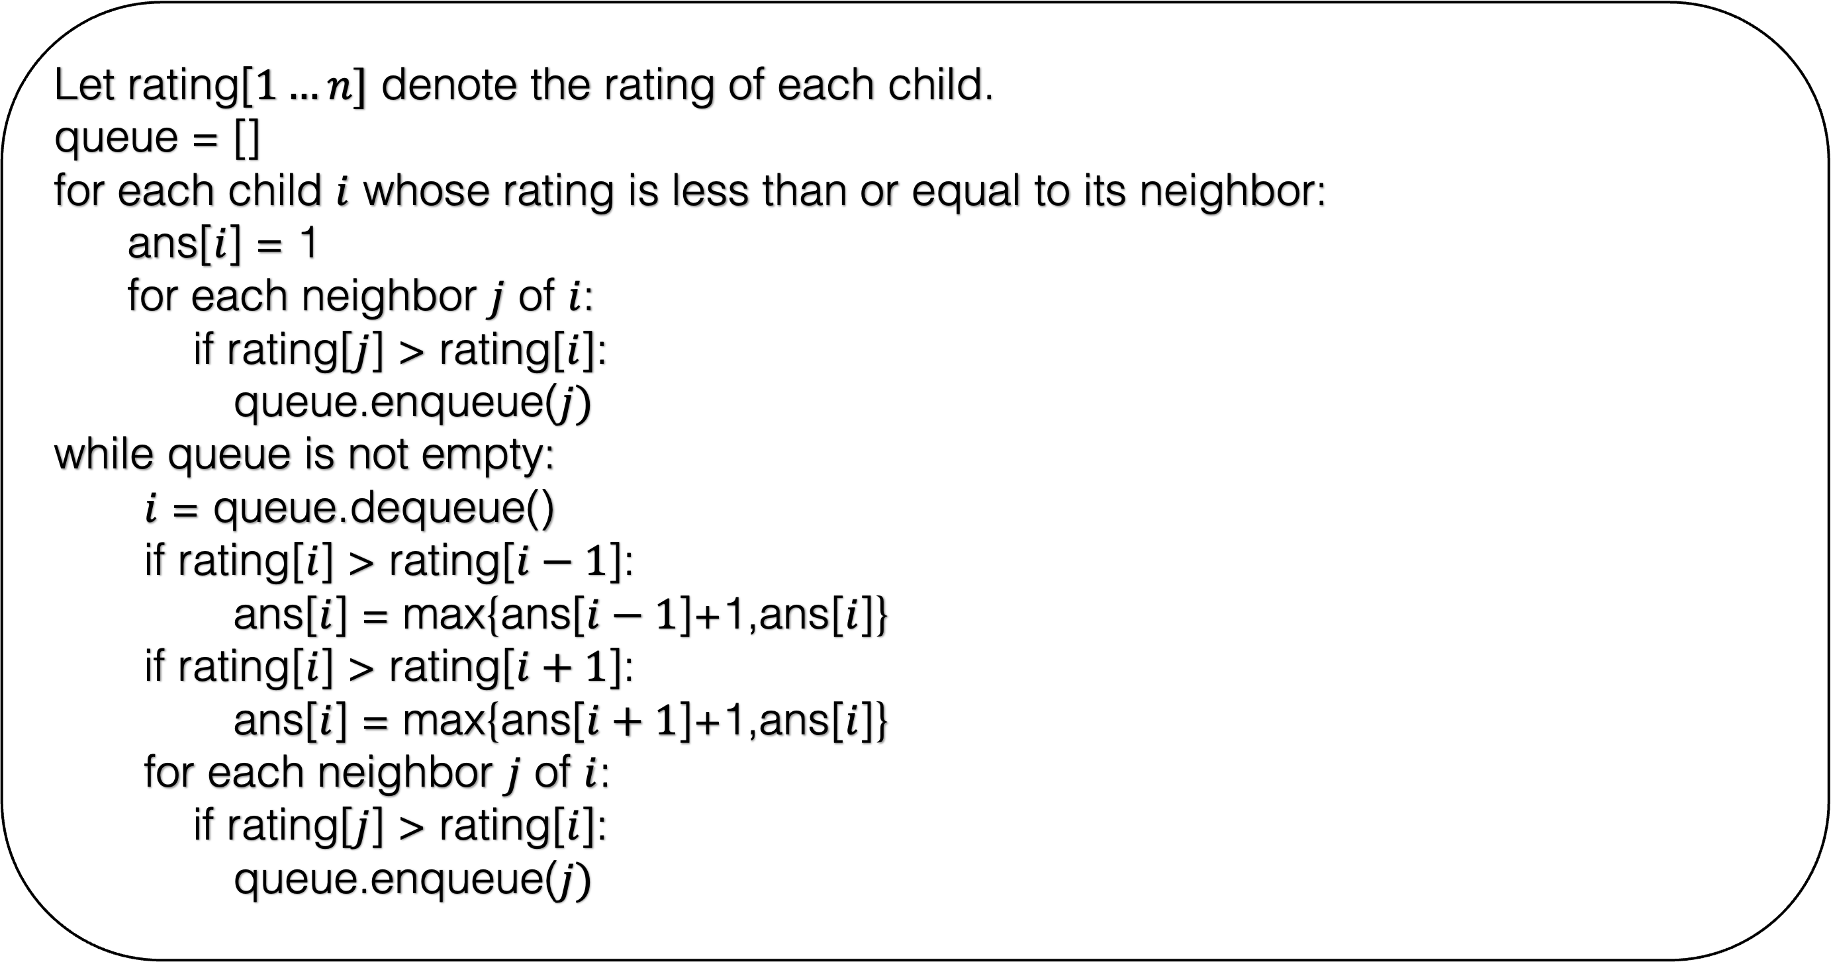
Let rating[$1…n]$ denote the rating of each child.
queue = []
for each child $i$ whose rating is less than or equal to its neighbor:
ans[$i$] = 1
for each neighbor $j$ of $i$:
if rating[$j$] > rating[$i$]:
queue.enqueue($j)$
while queue is not empty:
$i$ = queue.dequeue()
if rating[$i$] > rating[$i−1$]:
ans[$i$] = max{ans[$i−1$]+1,ans[$i$]}
if rating[$i$] > rating[$i+1$]:
ans[$i$] = max{ans[$i+1$]+1,ans[$i$]}
for each neighbor $j$ of $i$:
if rating[$j$] > rating[$i$]:
queue.enqueue($j)$
O($n$)
How many times can a child be added to the queue?

Slide 63
6
2
5
4
2
2
3
3
1
2
1
2
1
1
1
1
2
3
4
5
6
7
8
9

Slide 64
Never Added in the Queue
6
2
5
4
2
2
3
3
1
2
1
2
1
1
1
1
2
3
4
5
6
7
8
9

Slide 65
Never Added in the Queue
Added only once
6
2
5
4
2
2
3
3
1
2
1
2
1
1
1
1
2
3
4
5
6
7
8
9

Slide 66
Never Added in the Queue
Added only once
Added twice
6
2
5
4
2
2
3
3
1
2
1
2
1
1
1
1
2
3
4
5
6
7
8
9

Slide 67


Let rating[$1…n]$ denote the rating of each child.
queue = []
for each child $i$ whose rating is less than or equal to its neighbor:
ans[$i$] = 1
for each neighbor $j$ of $i$:
if rating[$j$] > rating[$i$]:
queue.enqueue($j)$
while queue is not empty:
$i$ = queue.dequeue()
if rating[$i$] > rating[$i−1$]:
ans[$i$] = max{ans[$i−1$]+1,ans[$i$]}
if rating[$i$] > rating[$i+1$]:
ans[$i$] = max{ans[$i+1$]+1,ans[$i$]}
for each neighbor $j$ of $i$:
if rating[$j$] > rating[$i$]:
queue.enqueue($j)$
O($n$)
O($n$)
Running time of the algorithm = O($n$)

Slide 68
Proof

Slide 69
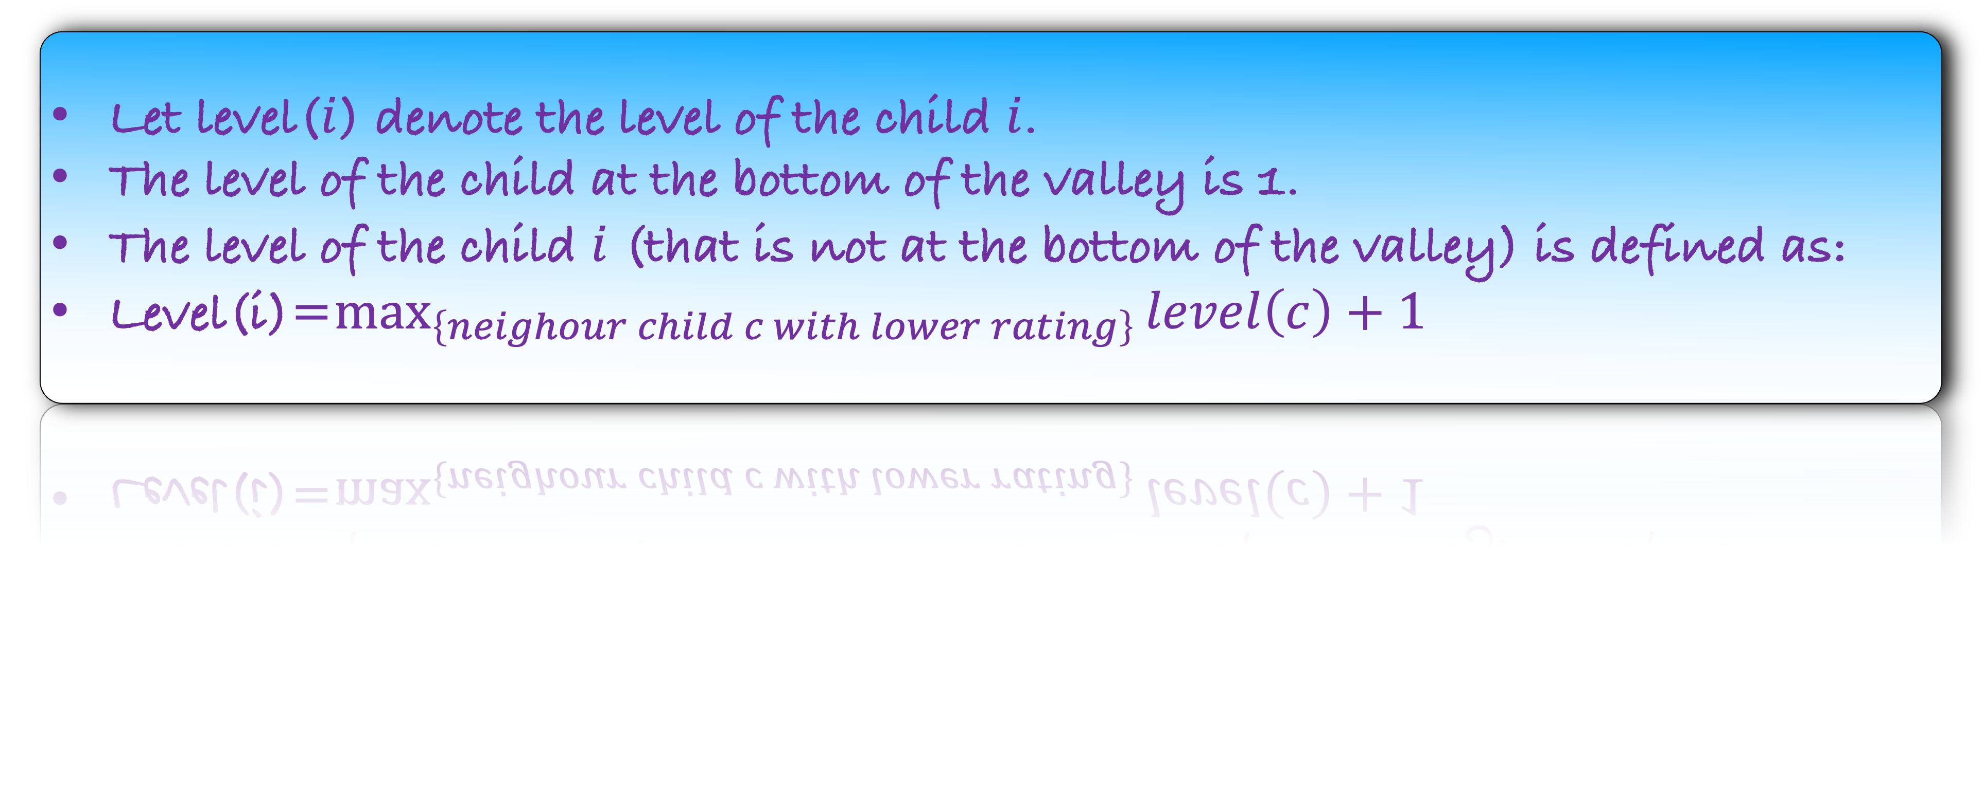
Let level($i$) denote the level of the child $i$.
The level of the child at the bottom of the valley is 1.
The level of the child $i$ (that is not at the bottom of the valley) is defined as:
Level(i)=$\max_{\left\{neighour child c with lower rating\right\}}{level\left(c\right)+1}$
Observation: level is actually the answer of our algorithm.
But why should the optimum behave the same way?

Slide 70
Greedy Proof Strategy: We are always better than the optimum.

Slide 71











Lemma: All level 1 children get one candy in any optimum answer.
6
$${. o}_{4}$$
Optimum Answer
5
4
$${ o}_{2}$$
$${. o}_{6}$$
$${. o}_{7}$$
3
$${. o}_{5}$$
2
$$o_{1}$$
$${. o}_{8}$$
1
$$o_{3}$$
$${. o}_{9}$$
1
2
3
4
5
6
7
8
9

Slide 72
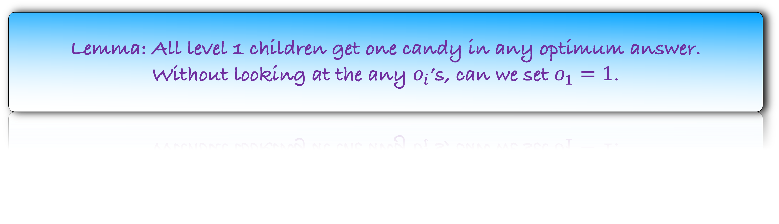
Lemma: All level 1 children get one candy in any optimum answer.
Without looking at the any $o_{i}$’s, can we set $o_{1}=1$.
6
$${. o}_{4}$$
Optimum Answer
5
4
$${ o}_{2}$$
$${. o}_{6}$$
$${. o}_{7}$$
3
$${. o}_{5}$$
2
$$o_{1}$$
$${. o}_{8}$$
1
$$o_{3}$$
$${. o}_{9}$$
1
2
3
4
5
6
7
8
9

Slide 73
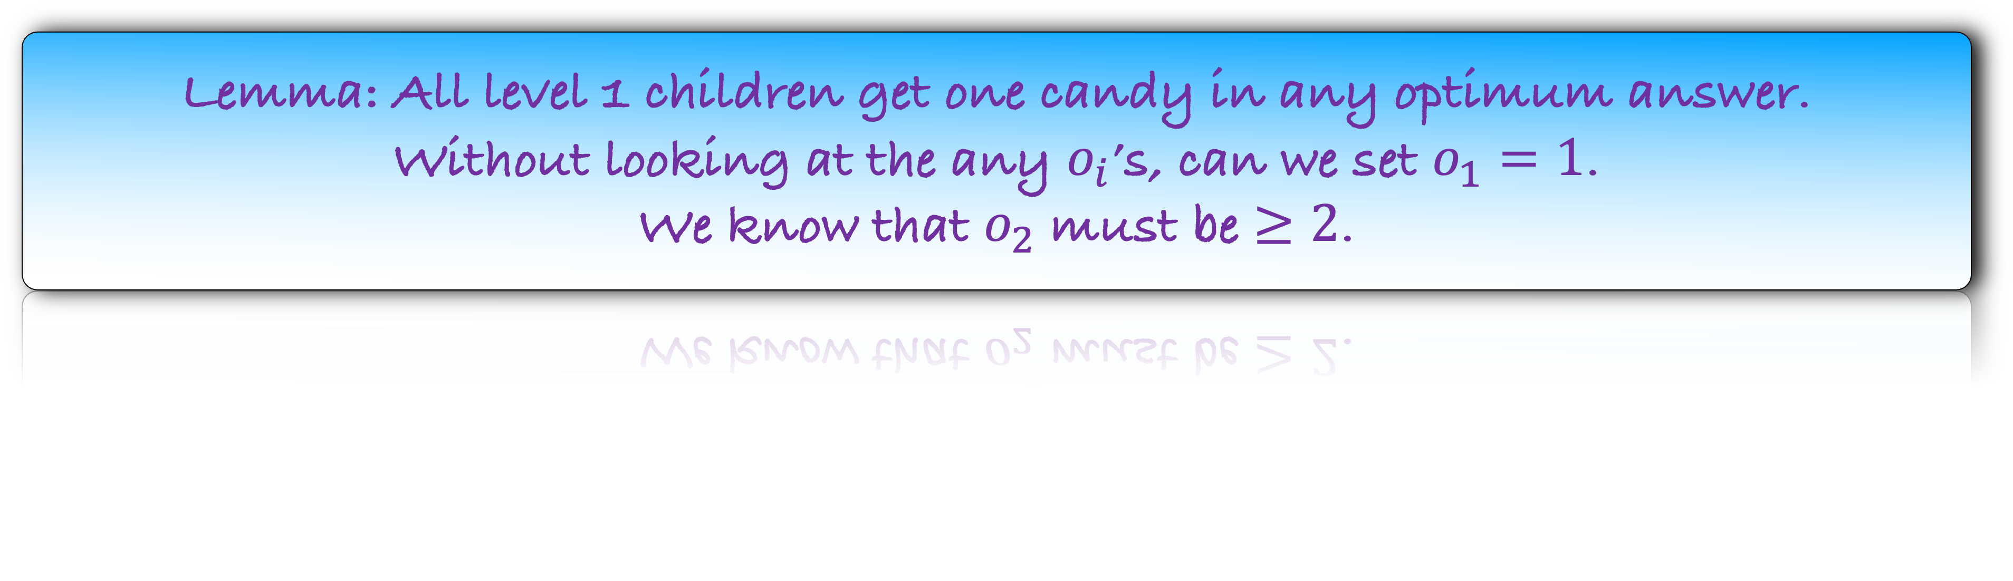
Lemma: All level 1 children get one candy in any optimum answer.
Without looking at the any $o_{i}$’s, can we set $o_{1}=1$.
We know that $o_{2}$ must be $≥2$.
6
$${. o}_{4}$$
Optimum Answer
5
4
$${ o}_{2}$$
$${. o}_{6}$$
$${. o}_{7}$$
3
$${. o}_{5}$$
2
$$o_{1}$$
$${. o}_{8}$$
1
$$o_{3}$$
$${. o}_{9}$$
1
2
3
4
5
6
7
8
9

Slide 74
Lemma: All level 1 children get one candy in any optimum answer.
Without looking at the any $o_{i}$’s, can we set $o_{1}=1$.
We know that $o_{2}$ must be $≥2$.
6
$${. o}_{4}$$
Optimum Answer
5
4
$${ o}_{2}$$
$${. o}_{6}$$
$${. o}_{7}$$
3
$${. o}_{5}$$
2
1
$${. o}_{8}$$
1
$$o_{3}$$
$${. o}_{9}$$
1
2
3
4
5
6
7
8
9

Slide 75
Lemma: All level 1 children get one candy in any optimum answer.
Without looking at the any $o_{i}$’s, can we set $o_{1}=1$.
We know that $o_{2}$ must be $≥2$.
6
$${. o}_{4}$$
Optimum Answer
5
4
$${ o}_{2}$$
$${. o}_{6}$$
$${. o}_{7}$$
3
1
2
1
$${. o}_{8}$$
1
1
1
1
2
3
4
5
6
7
8
9

Slide 76
Lemma: All level 1 children get one candy in any optimum answer.
6
$${. o}_{4}$$
Optimum Answer
5
4
$${ o}_{2}$$
$${. o}_{6}$$
$${. o}_{7}$$
3
1
2
1
$${. o}_{8}$$
1
1
1
1
2
3
4
5
6
7
8
9

Slide 77
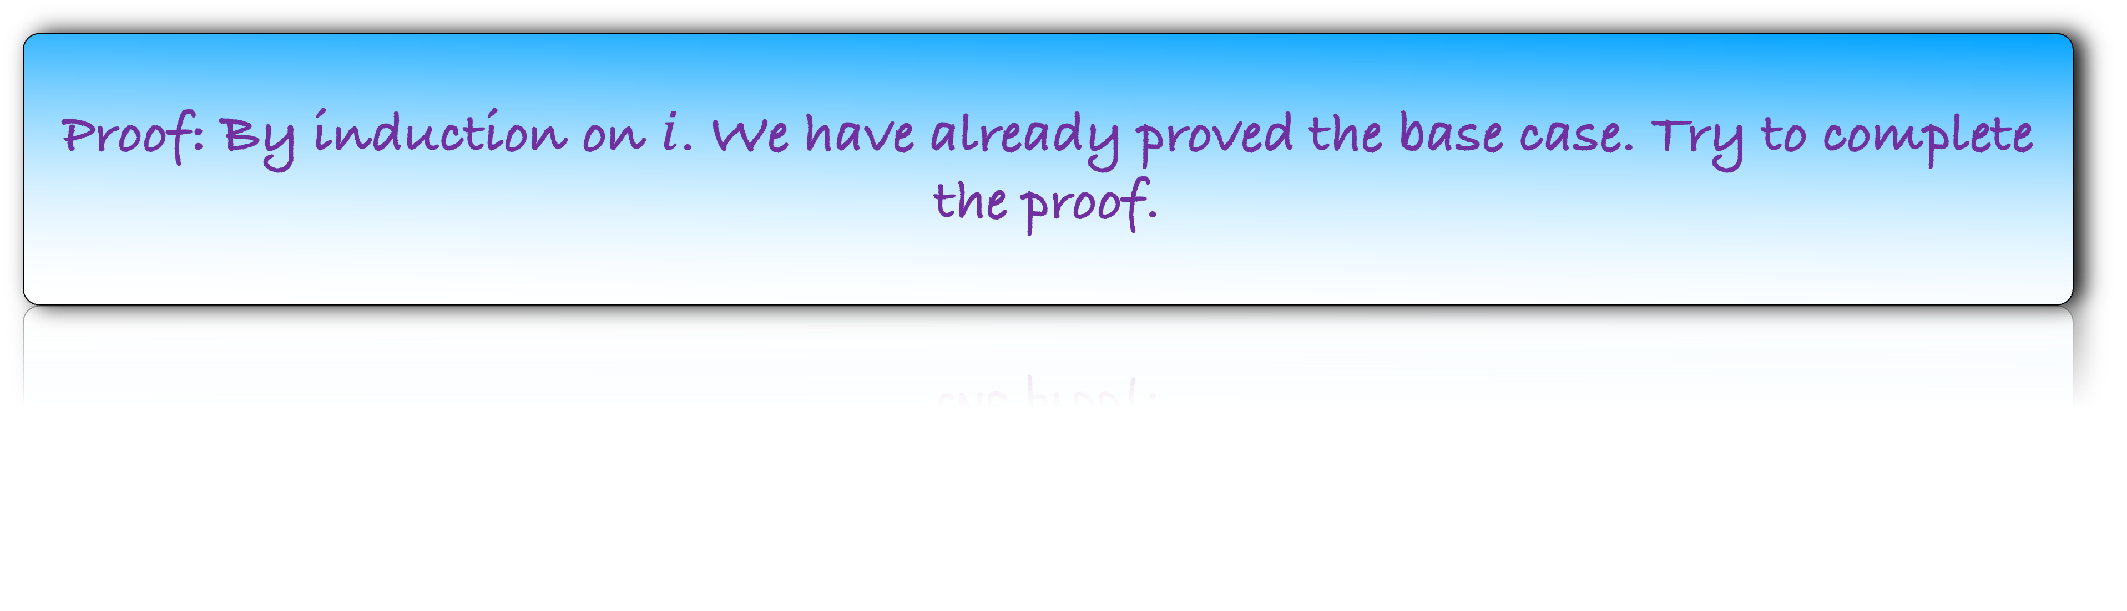
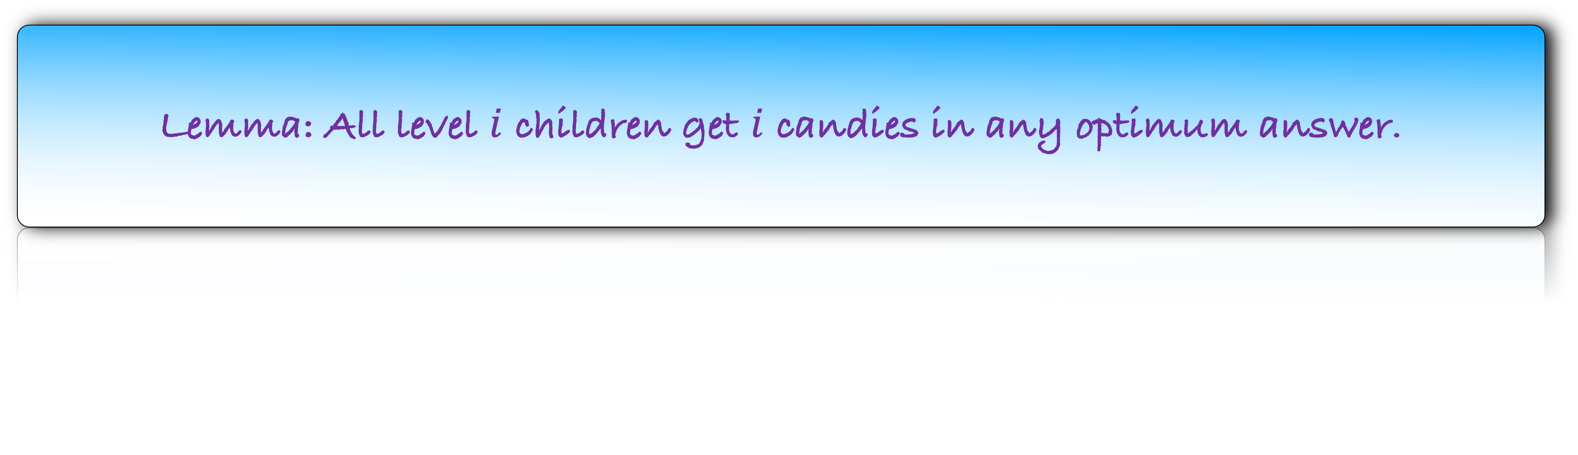
Lemma: All level $i$ children get $i$ candies in any optimum answer.
Proof: By induction on $i$. We have already proved the base case. Try to complete the proof.

